Slide 1
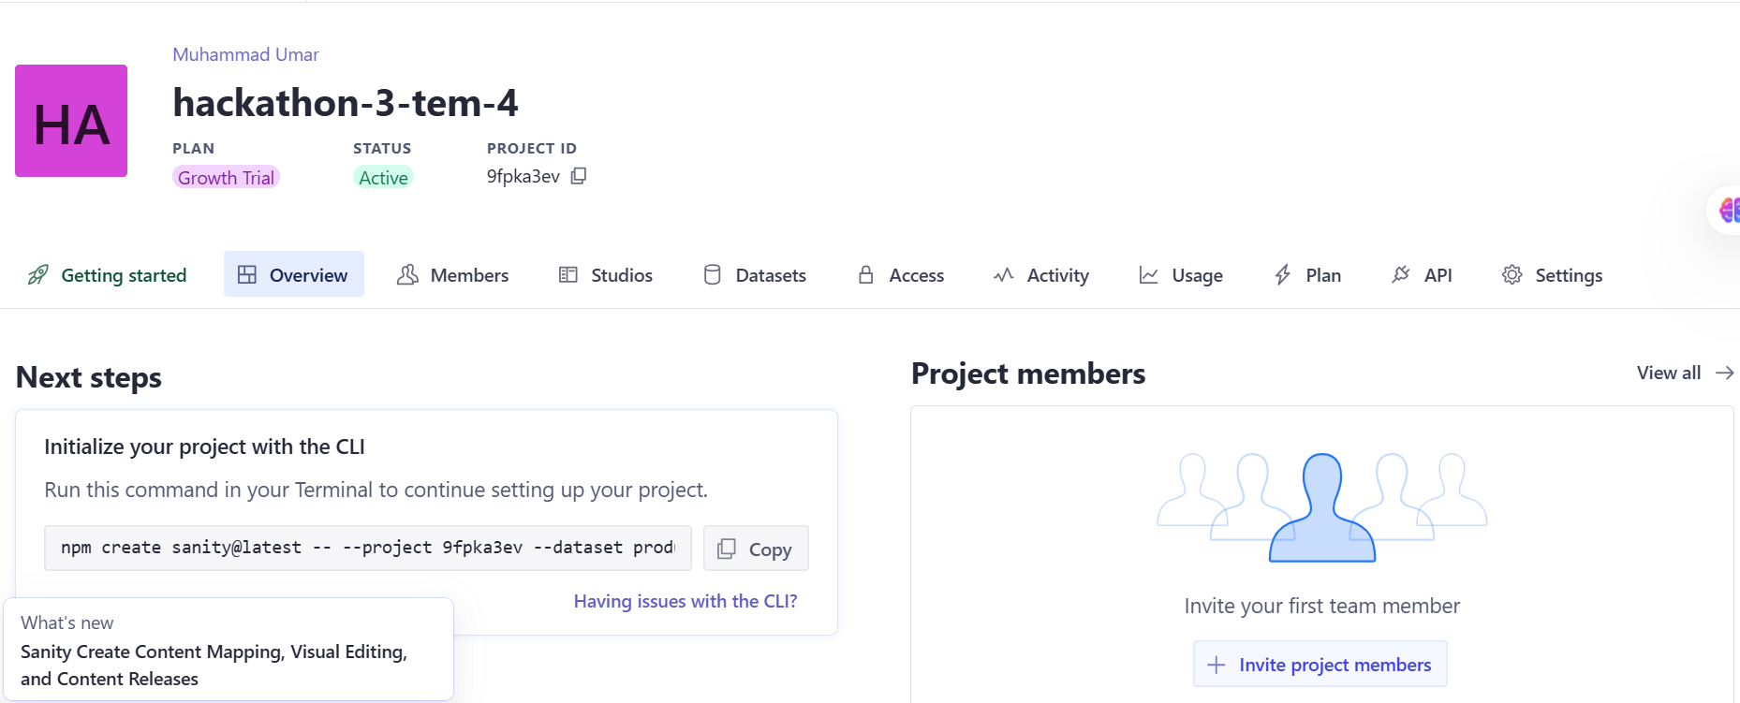
Hackathon Report Day 3
Presented by
Shagufta Zakir
API INTEGRATION AND DATA MIGRATION
API Integration steps:
Step 1: Install Sanity in the Next.js Project
Begin by setting up Sanity in your Next.js project.
Create a new project in Sanity and retrieve the project ID and token. it will be utilized in the Next.js application for API integration
Step 2: Define Schemas in the Sanity Folder
Navigate to the sanity/schemas folder in your Sanity project directory.
Create a file named Products.ts and define the schema for products.
Step 3: Setup Scripts for Data Migration
At the project root, create a folder named scripts.
Inside this folder, create a file named importSanityData.mjs.
This file will be used to import the provided data into Sanity.

Slide 2
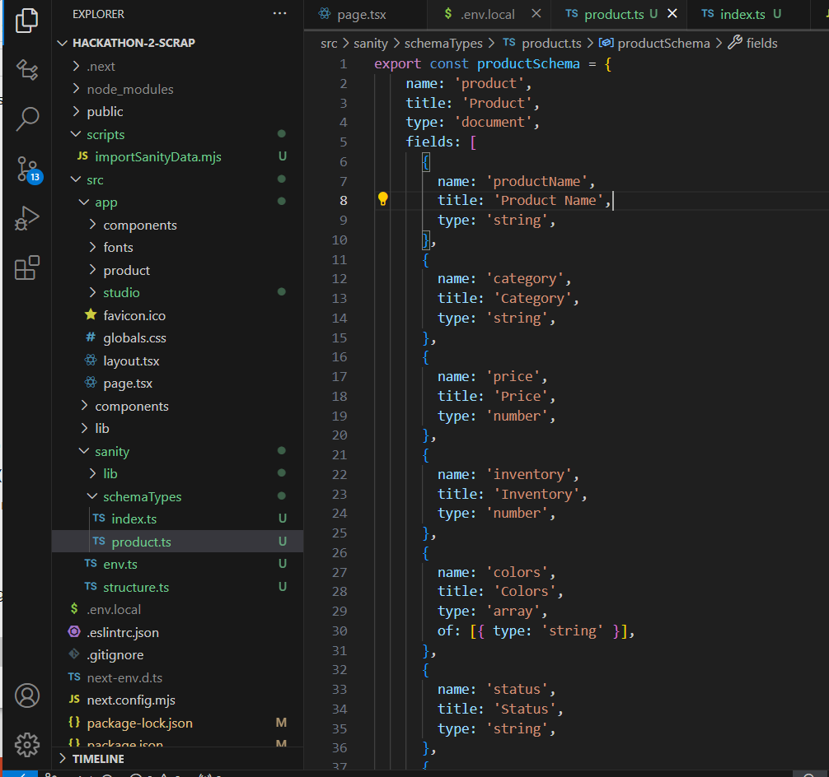
Step 4: Install Required Dependencies
Run the following command in the terminal to install the necessary packages
npm install @sanity/client axios dotenv
Step 5: Update package.json
Add the following script to the package.json file.
"import-data": "node scripts/importSanityData.js"
Step 6: Import Data into Sanity
To execute the data import, run the following command in the terminal:
npm run import-data
2. Adjustments Made to Schemas:
The Product schema defines how product data is structured and organized
within the Sanity content platform. Its purpose is to store detailed information
about each product in a way that ensures flexibility and supports various use
cases, such as e-commerce platforms or product catalogs.

Slide 3
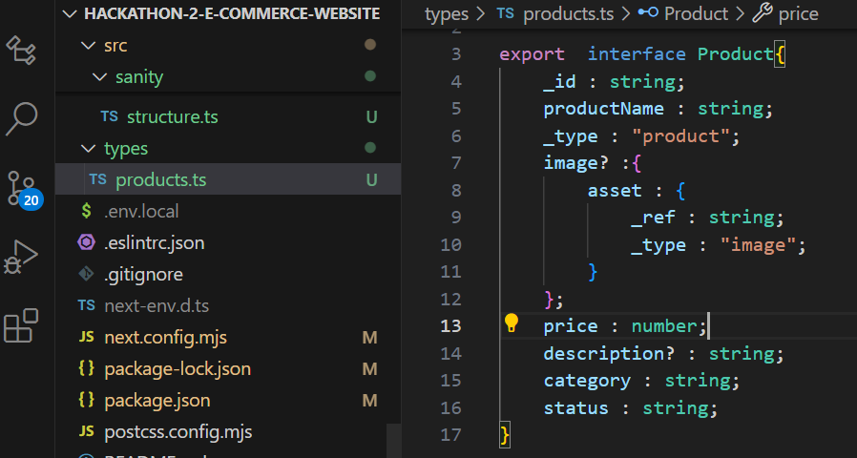
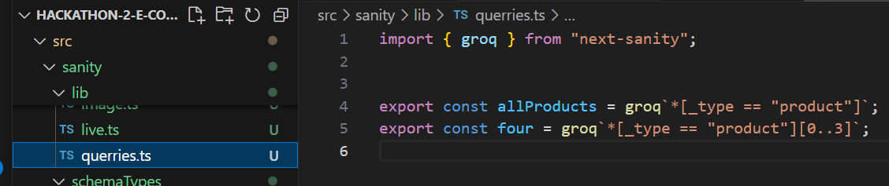
3. Migration Steps and Tools Used:
1.Query Setup:
A query is defined to fetch complete and well-structured product data from the Sanity backend.
2. Code Overview:
The code initializes a Sanity client using the createClient function provided by the next-sanity package.
This client connects the application to the Sanity CMS project by specifying the projectId, dataset, and apiVersion.
A reusable sanityFetch function is created for querying data dynamically. This function accepts a query string and optional params to make data retrieval flexible and efficient.
By using this setup, the application retrieves content dynamically and simplifies data management.

Slide 4
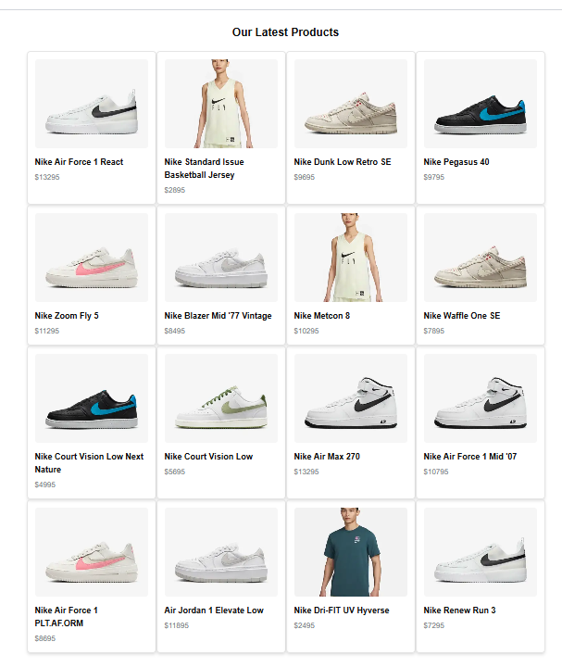
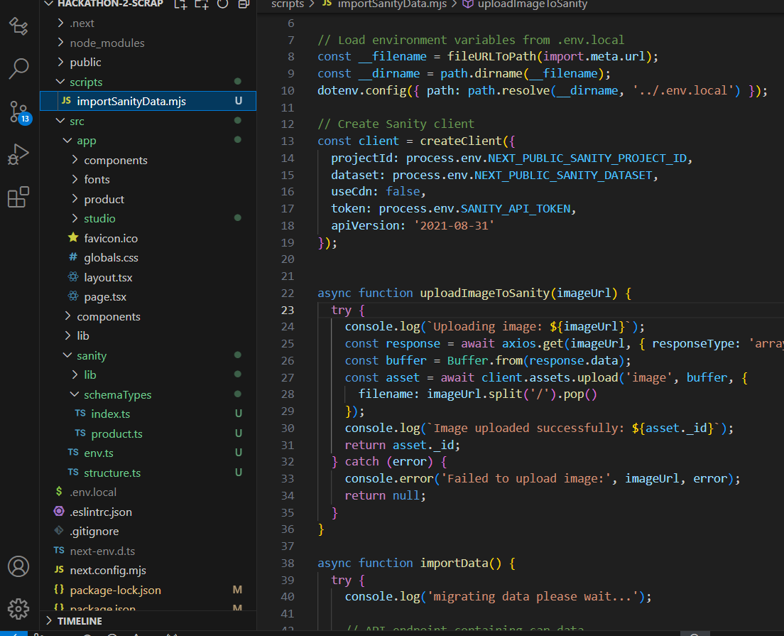
Importing Data into sanity
DATA SUCCESSFULLY DISPLAY IN FRONTEND
The process involves setting up the Sanity CMS and importing data to create a dynamic and structured database. This allows seamless management and retrieval of product data. Once the data is successfully imported, it can be used for building dynamic applications

Slide 5
Day 3 Checklist: Self-validation checklist
API Understanding: ✔
Schema Validation: ✔
Data Migration: ✔
API integration in next.js: ✔
Submission preparation: ✔

